Slide 1
AIM
Machine learning model to detect artefacts like Eye Blink and Jaw Clench in the EEG signals

Slide 2
Introduction
The dataset consists of 14-channel EEG data sampled at 128Hz i.e 128 samples
per second for 6 minutes. Each data sample contains 19 columns. The dataset
consists of 84 markers (2 baseline markers and 82 markers for eye blinks and
jaw clenches).The first 30 seconds of the data consists of baseline data, with the
first seconds recorded with eyes open and the remaining 15 with eyes open.
Marker type value helps you recognize whether the marker is of type instance
or Interval.

Slide 3
Approach of problem
As per my understanding regarding the data I have applied two different solution for breaking the data
Solution – 1 :- For separating the data, based on the label of the column “MarkerValueInt”, I have extracted the data for time interval = 23 for Jaw Clinching and added this segment of data as a column in a new data frame. This process was repeated for every such segment of data.
A similar process was also repeated for extracting data for time interval= 22 for Eye Blink.
Solution 2: I extracted the row data for label= 22 and label=23 separately and created a new data frame for both respectively.

Slide 4
Data pipeline steps for Solution – 1
Load the data
Apply the function involved in data processing
Perform feature extraction and convert into standard file format
Develop the machine learning model

Slide 5
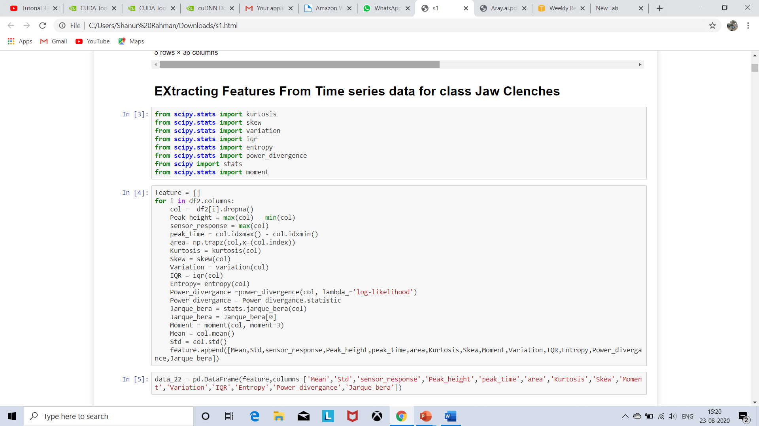
Feature Extraction :-
The features extracted from time series data and stores the results in feature dataset only for column name EEG.AF3.
There are two kinds the features extraction :-
Mathematical Features :- These features are extracted from mathematics applied in time series signals like Area, Sensor response, time to peak, Peak height.
Statistical Features :- The features are extracted using statistical methods like mean, standard deviation, Kurtosis, skew etc.

Slide 6
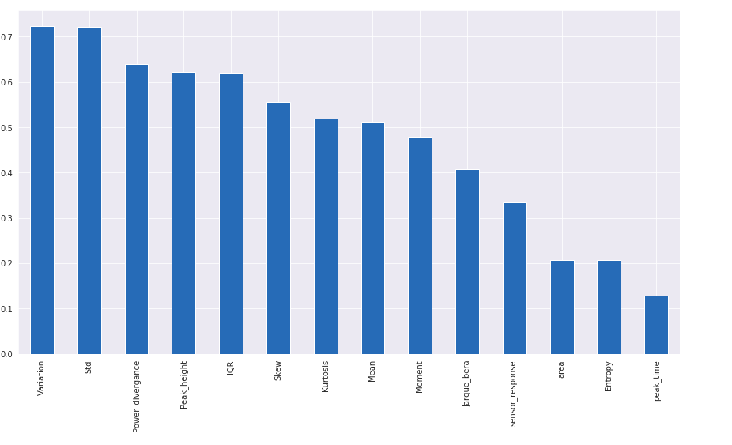
Data Analysis
Correlation Plot using Target Variable ( Jaw Clench and Eye Blink )

Slide 7
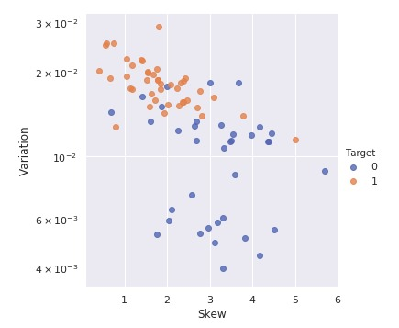
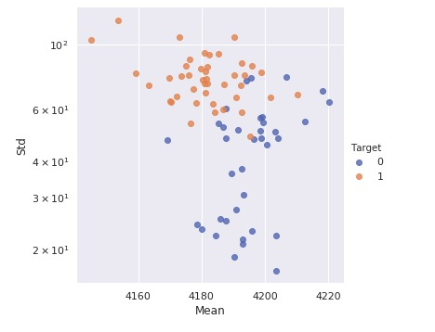
Data Analysis in 2D
Interpretation - Two classes Jaw Clench and Eye Blink have distinct boundaries with some
exception hence they can be classified very smoothly
O - Jaw Clench
1 - Eye Blink )

Slide 8
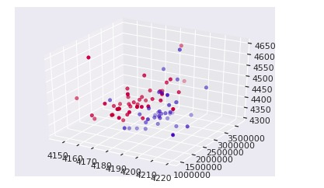
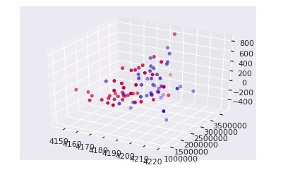
Data Analysis in 3D
Interpretation - Two classes Jaw Clench and Eye Blink have distinct boundaries with some
exception hence they can be classified very smoothly
Red- Jaw Clench
Blue - Eye Blink )

Slide 9
Model Building & Testing
Depending on company requirement we can write it manually Machine learning algorithm or use
sklearn library to import Machine learning algorithm
Interpret Model
Interpreting complex models are of fundamental importance in machine learning. Model
Interpretability helps debug the model by analyzing what the model really thinks is important.
Multiple Layer Stacking Models
Base models can be in a single layer or in multiple layers in which case the predictions from each
preceding layer is passed to the next layer as an input until it reaches meta-model where predictions
from all the layers including base layer is used as an input to generate final prediction.

Slide 10
Model Building & Testing
Bagging Models
Bagging, also known as Bootstrap aggregating, is a machine learning ensemble meta-algorithm
designed to improve the stability and accuracy of machine learning algorithms used in statistical
classification and regression. It also reduces variance and helps to avoid overfitting. Although it is
usually applied to decision tree methods, it can be used with any type of method. Bagging is a
special case of the model averaging approach.
Boosting Models
Boosting is an ensemble meta-algorithm for primarily reducing bias and variance in supervised
learning. Boosting is in the family of machine learning algorithms that convert weak learners to strong
ones. A weak learner is defined to be a classifier that is only slightly correlated with the true
classification (it can label examples better than random guessing). In contrast, a strong learner is a
classifier that is arbitrarily well-correlated with the true classification

Slide 11
Machine Learning Results based on Actual Features
Random Forest
Accuracy – 83 %
 | Precision | Recall | f1-score | Support
0 | 0.80 | 0.86 | 0.80 | 10
1 | 0.86 | 0.86 | 0.86 | 14
Macro Average | O.83 | 0.83 | 0.83 | 24
Weighted Average | 0.83 | 0.83 | 0.83 | 24

Slide 12
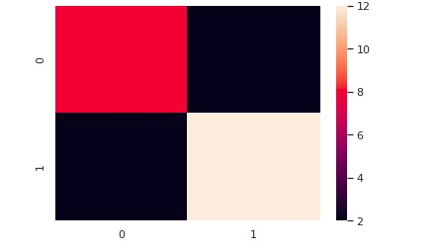

Confusion Matrix
Picture Interpretation
Numerical Interpretation

Slide 13
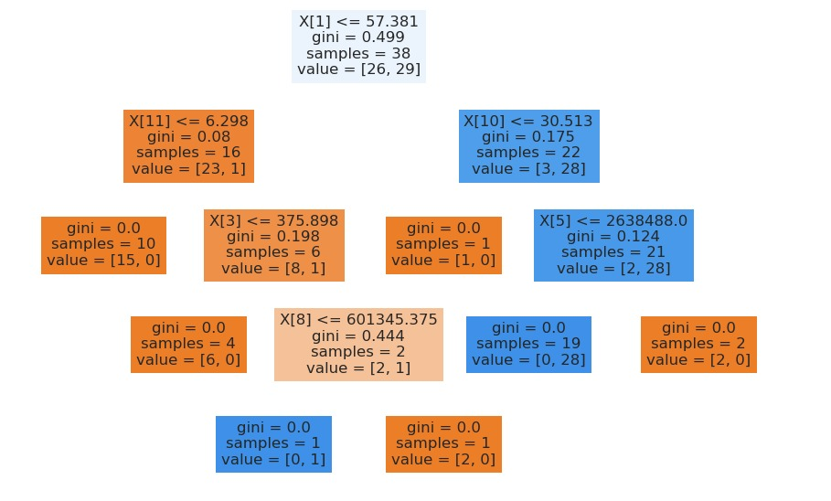
Visualization of Random Forest
Visualization of first Stomps of
random Forest
I have created 100 Stomps for random forest base model.

Slide 14
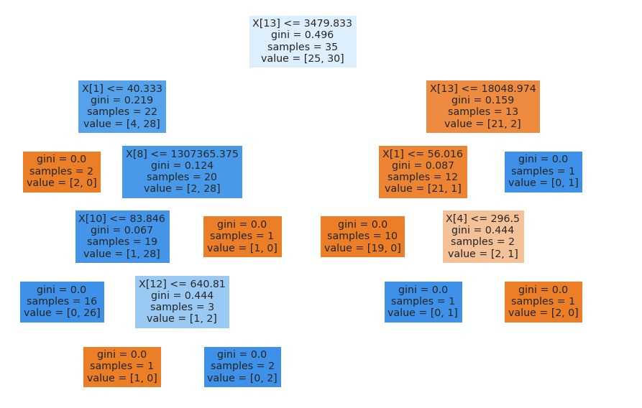
Visualization of Random Forest
Visualization of Second Stomps of
random Forest
I have created 100 Stomps for random forest base model.

Slide 15
Calibrate Model
When performing Classification experiments you often want to predict not only the class labels, but
also obtain a probability of the prediction. This probability gives you some kind of confidence. Some
models can give you poor estimates of the class probabilities. Well calibrated classifiers are
probabilistic classifiers for which the probability output can be directly interpreted as a confidence
level.
I have created 4 base model for calibrate the model
Random Forest
AdaBoostClassifier
K Neighborsclassifier
Logistic Regression

Slide 16
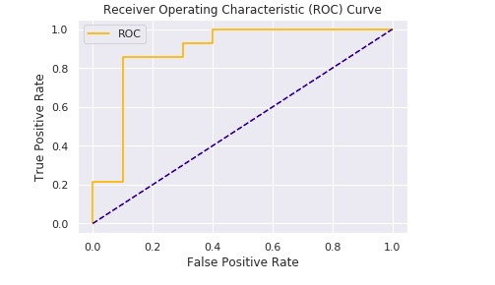
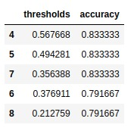
Calibrate Model ROC AND AUC Curve
From side image I have calibrate the model and its threshold value should be
0.56 for best accuracy.

Slide 17
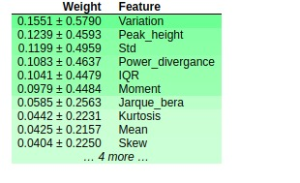
Interpreting EEG prediction with Eli5 Lib
Weight’s effect for different
Independent variables on model
Prediction
Narrative
1) Now it shows the feature names alongside their weight
2) How each feature contribute to influence the prediction
3) Bias means an intercept
4) Bias is the intercept where our line intercepts the y-axis for (linear regression). In ML we can call intercepts bias.
5) Bias offsets all predictions that we make.

Slide 18
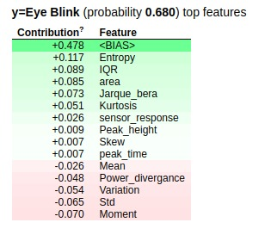
Interpreting EEG prediction with Eli5 Lib
Weight’s effect for different
Independent variables on model
prediction for class Eye Blink
Conclusion
Each of the various libraries has their own method of interpreting the model
Each was able to explain why our selected prediction was non-DM

Slide 19
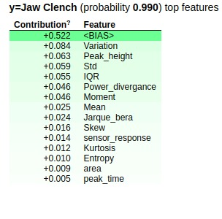
Interpreting EEG prediction with Eli5 Lib
Weight’s effect for different
Independent variables on model
prediction for class Jaw Clench
Conclusion
Each of the various libraries has their own method of interpreting the model
Each was able to explain why our selected prediction was non-DM

Slide 20
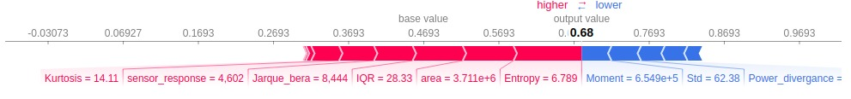
Interpreting EEG prediction with Shap Lib
Effect of Independent classes on single prediction for Eye Blink
Narrative
1) Normal base value =.0.4692727272727275
2) The sum of the red and the blue = output 0.97
3) All the features in red are pushing the prediction from the base value to the prediction value

Slide 21
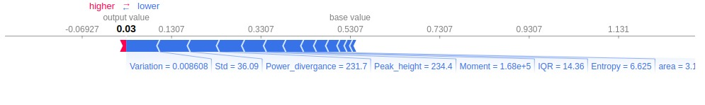
Interpreting EEG prediction with Shap Lib
Effect of Independent classes on single prediction for Jaw Clench
Narrative
1) Normal base value =.0.4692727272727275
2) The sum of the red and the blue = output 0.97
3) All the features in red are pushing the prediction from the base value to the prediction value

Slide 22
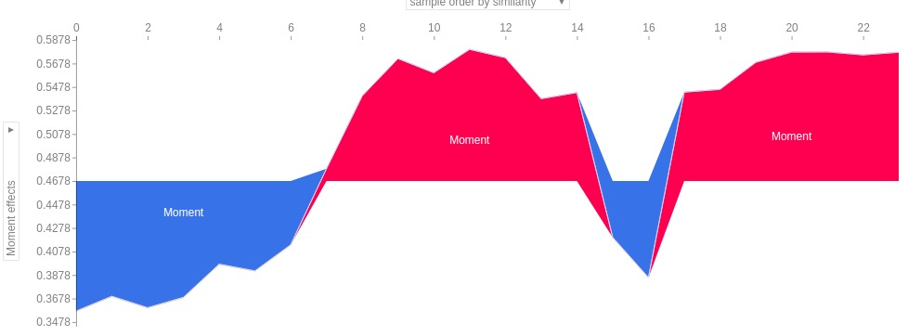
Interpreting EEG prediction with Shap Lib Effect of Different Independent variable on prediction
Effect of Sample order by
similarity and Moment effects

Slide 23
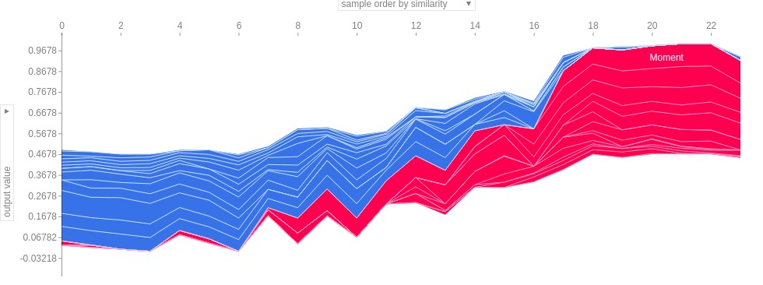
Interpreting EEG prediction with Shap Lib Effect of Different Independent variable on prediction
Effect of Sample order by
similarity and Target Variable

